Slide 1
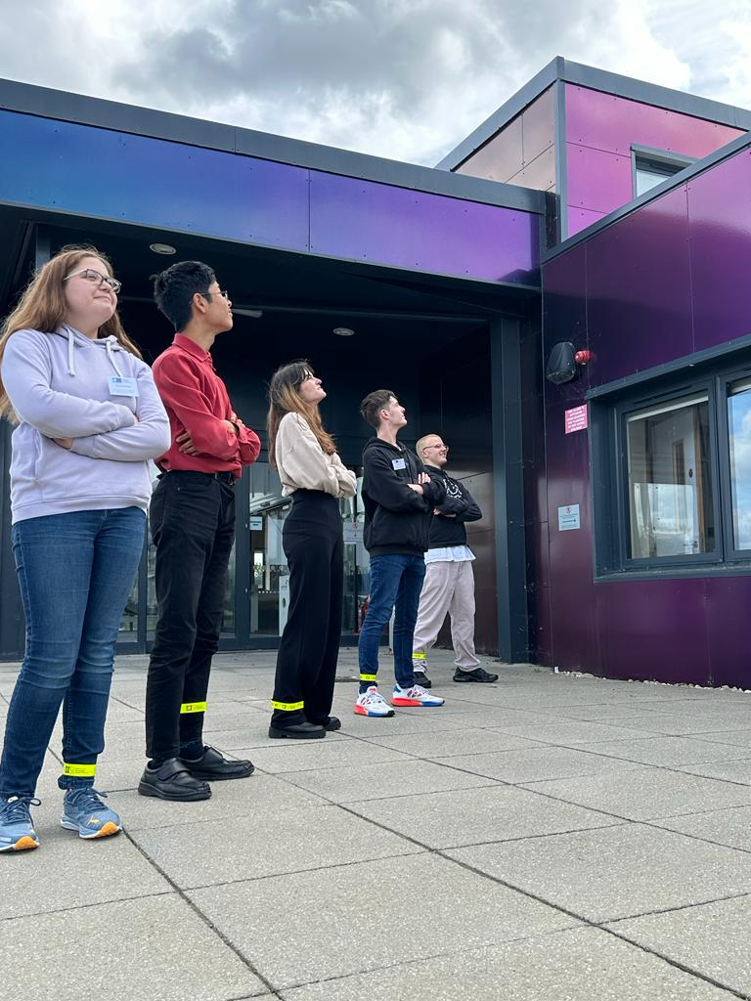
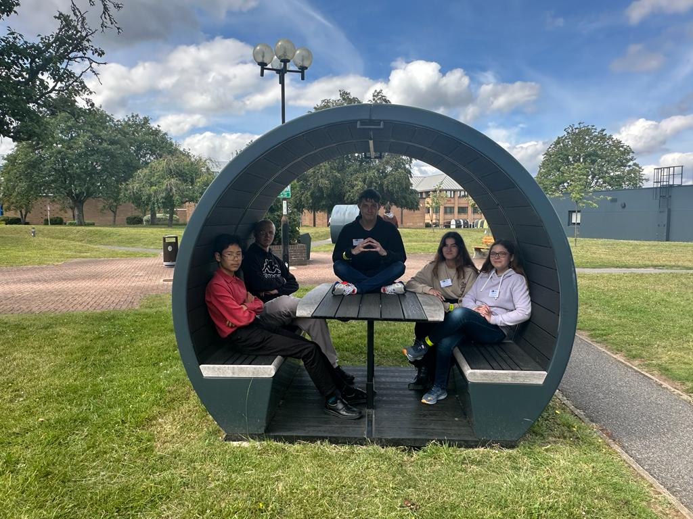
Waterfall project
Charlotte, Helga, Harrison, Ben, Henrique
RAL Visitor Centre
07.07.23

Slide 2

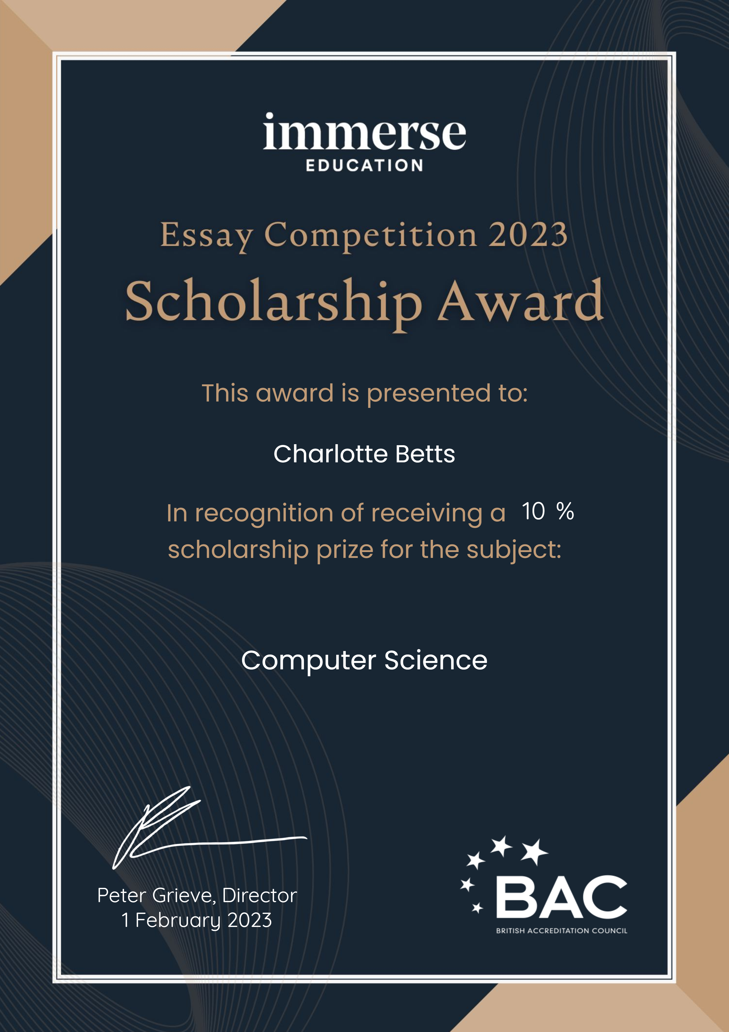


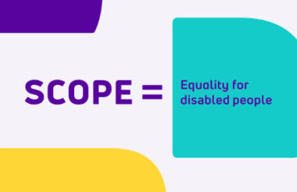
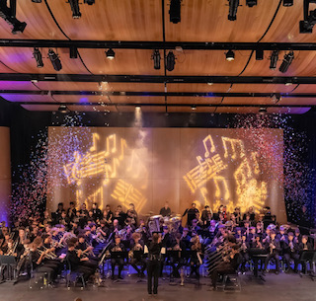
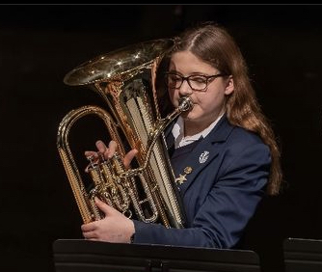
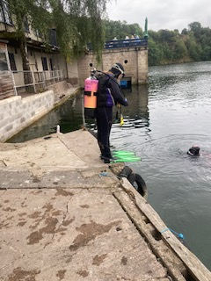
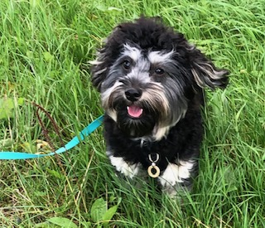
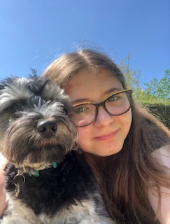
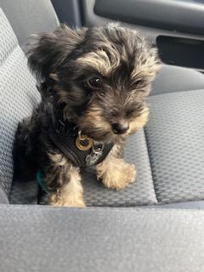
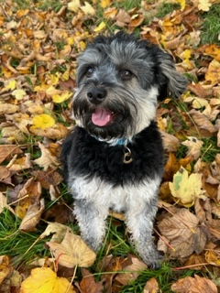
Charlotte Betts (Year 10)
Debating
Combined Cadet Force
Maths Society
Volunteer to help at science and maths clubs for younger years
Euphonium
Badminton
Netball
SCUBA diving
Universal Justice
Volunteering at Scope
DofE
Toby (my dog)Adventures / hobbies / pets / achievements / likes / ambitions
How has this experience benefited you?
If this experience has been useful, we would be happy to hear it!
If you now know that you hate python for example, that is a big win! We won’t feel bad, this is about you not us.
Consider things like teamwork, sharing perspectives, approaching problem solving, etc
Feedback also welcome; e.g. “more tours”, “less git”, “more biscuits”…

Slide 3
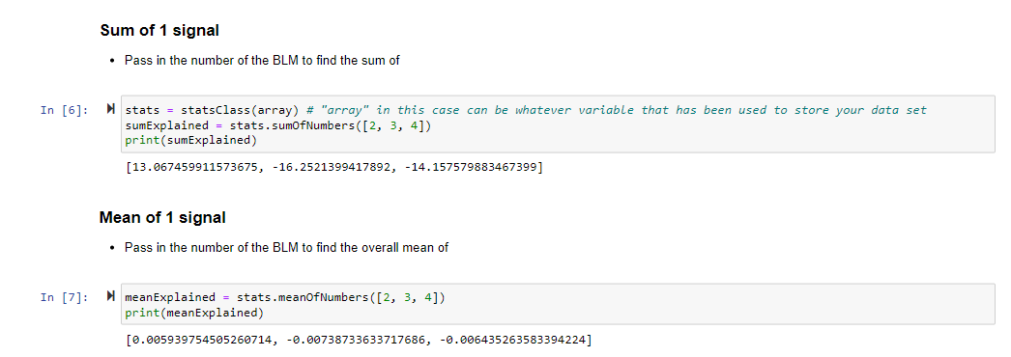
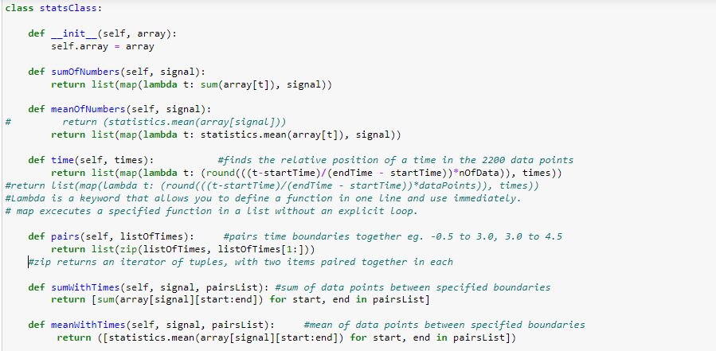
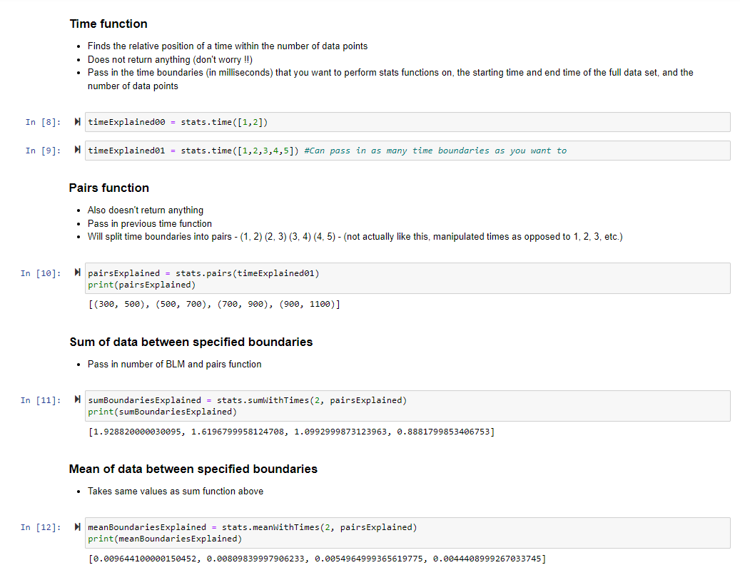
Stage 1 Projects: Group 1B: Statistics
Functions for summing and means, (time intervals & class)
Improving efficiency and optimising the code
What you contributed to your team / goals / tasks
Don’t forget update presentations, demo presentations, these presentations, communication tasks, documentations tasks – we focus on the product but this requires a vast amount of other contribution types (not just some python code)
Focus on a few things – remember you should aim to get this slide done in 30 – 45 seconds
What you learnt (if you want)
What you enjoyed or the opposite (if you want)
Your struggles and victories, personal and group / cohort (if you want)
Your self defined success (if you want)
Other interesting things (if you want)

Slide 4
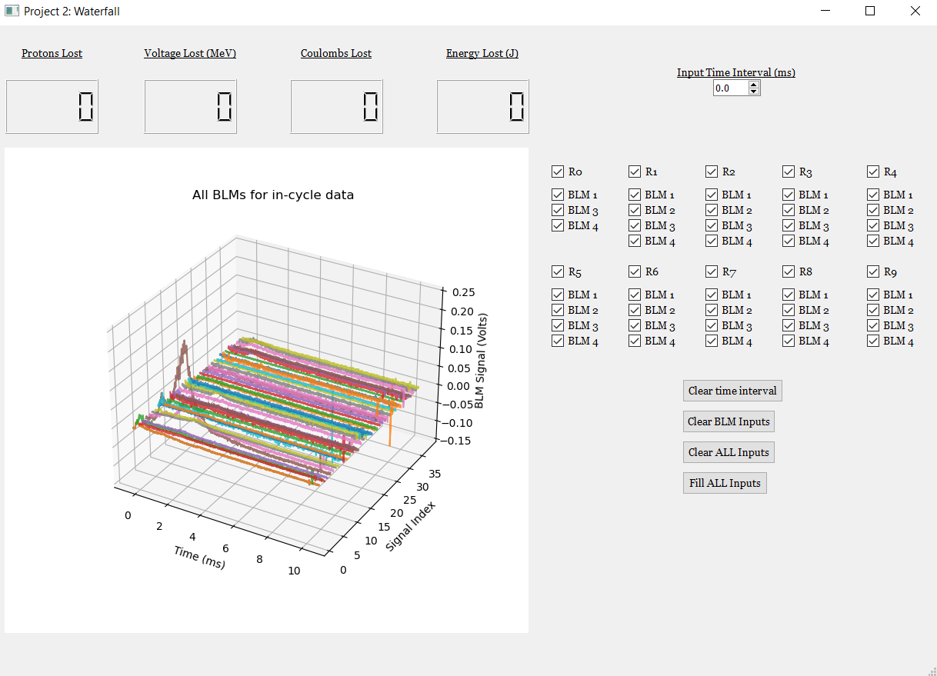
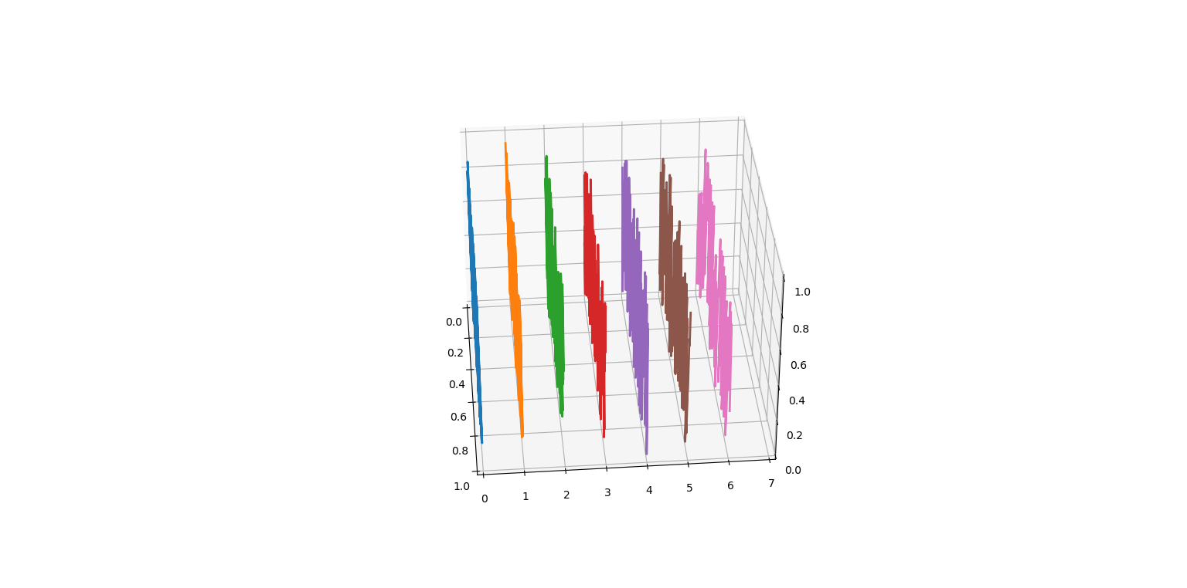
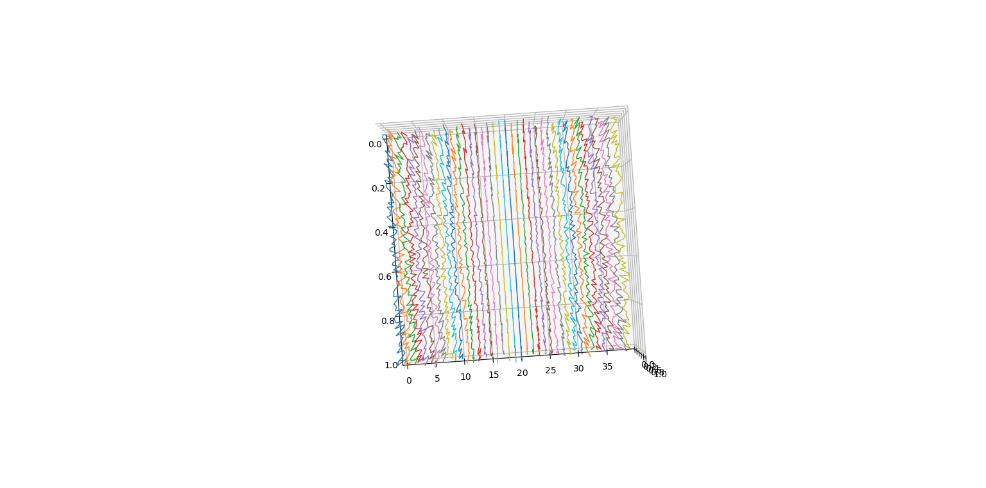
Stage 2 Projects: Waterfall GUI
Animating a 3D waterfall graph, having the lines shift (ultimately not used in final project)
Editing and fixing errors in the GUI, including making it live update
What you contributed to your team / goals / tasks
Don’t forget update presentations, demo presentations, these presentations, communication tasks, documentations tasks – we focus on the product but this requires a vast amount of other contribution types (not just some python code)
Focus on a few things – remember you should aim to get this slide done in 30 – 45 seconds
What you learnt (if you want)
What you enjoyed or the opposite (if you want)
Your struggles and victories, personal and group / cohort (if you want)
Your self defined success (if you want)
Other interesting things (if you want)

Slide 5
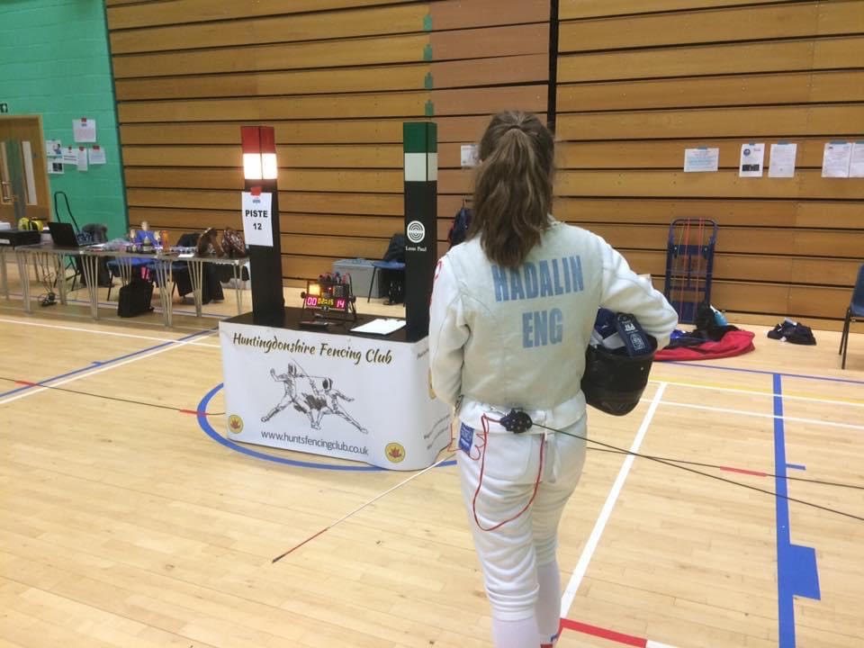
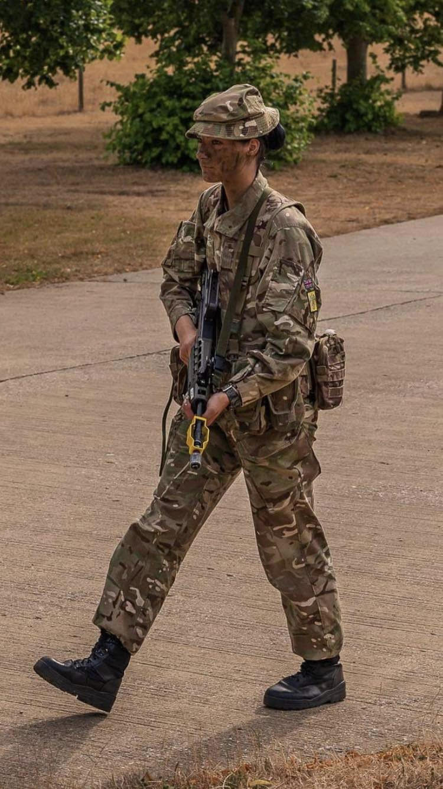
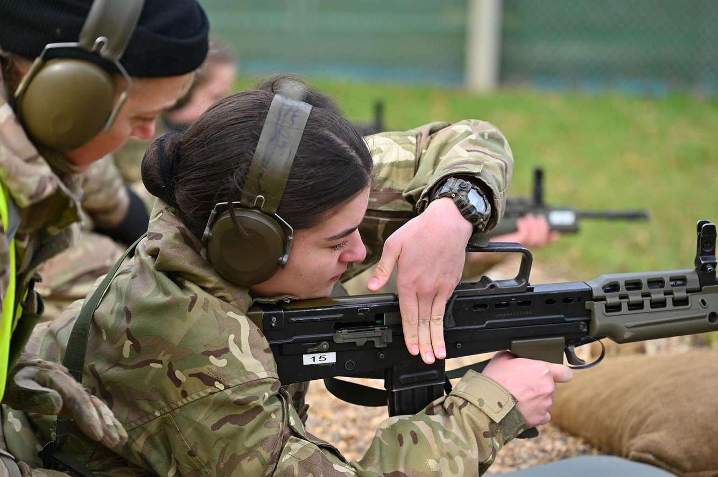
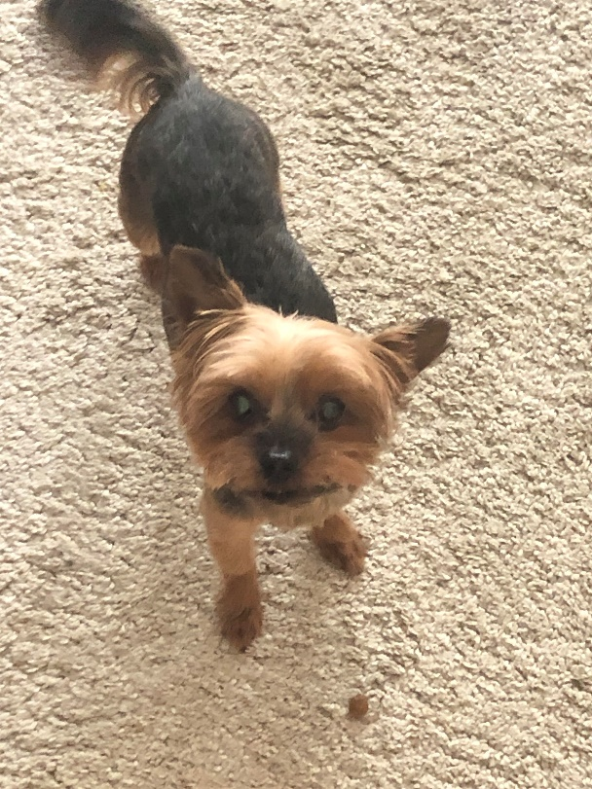
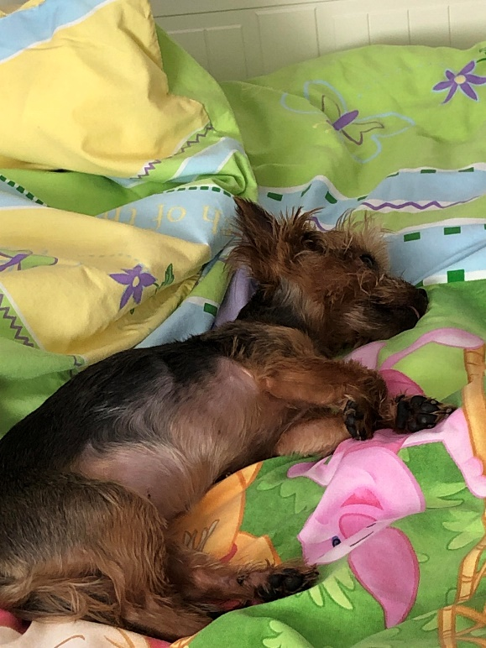
Personal Introduction & How Has This Work Experience Benefited You?
My name is Helga.
I fence competitively and do shooting as a hobby.
I’m also in the ACF and I hold the rank of CSM.
I have one dog who I’ve grown up with called Rosie.
This experience has taught me how to interact with a group of people that I have never met and work towards an end project co-operatively regardless of not knowing each other. I also learnt what matplotlib is.

Slide 6
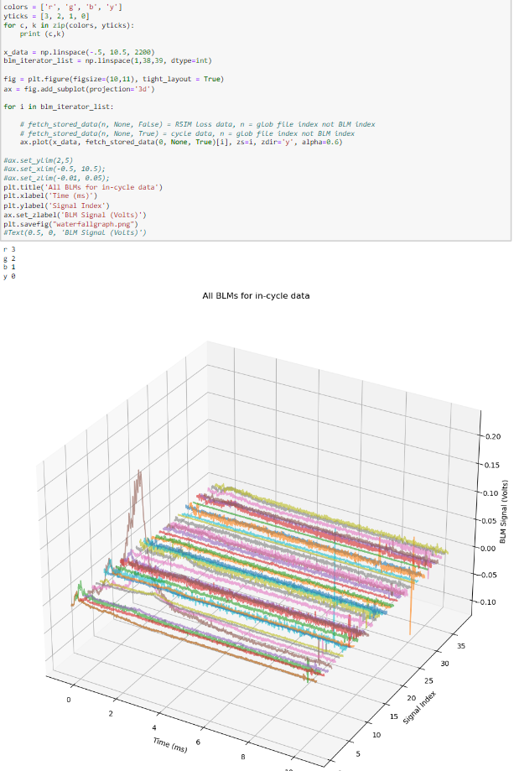
Stage 1 Projects: Group 1H: Plotting
In Stage 1, the group I was in was tasked with creating functions for graphs to make plotting easier.
A specific task I did was focusing on creating a function for a waterfall plot.
In this project, I was able to develop an understanding of matplotlib and how to create a 3d axis within python.

Slide 7
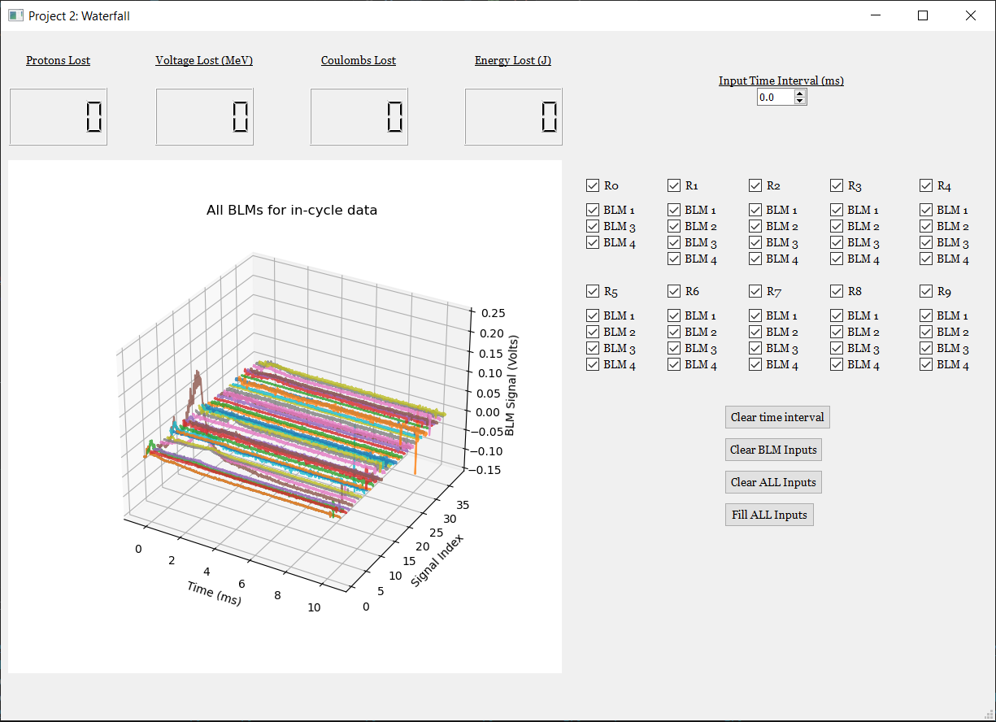
Stage 2 Projects: Waterfall GUI
In stage 2, I helped to organise what we had left to do as I was the only one with the waterfall code at the time.
I worked very closely with Charlotte in this project, we worked together to create a live updating graph with incoming data.

Slide 8
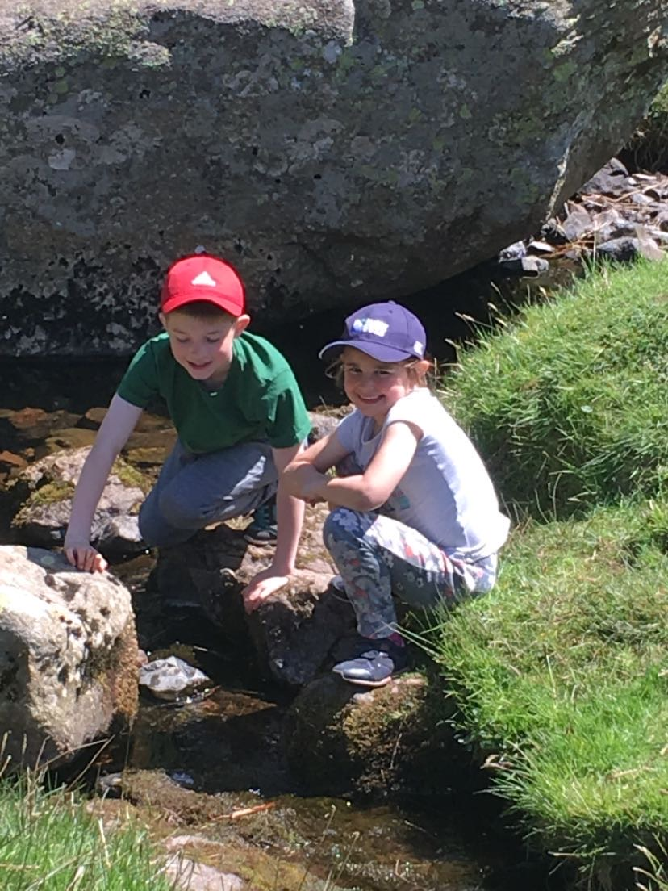
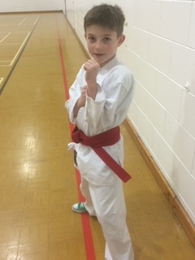
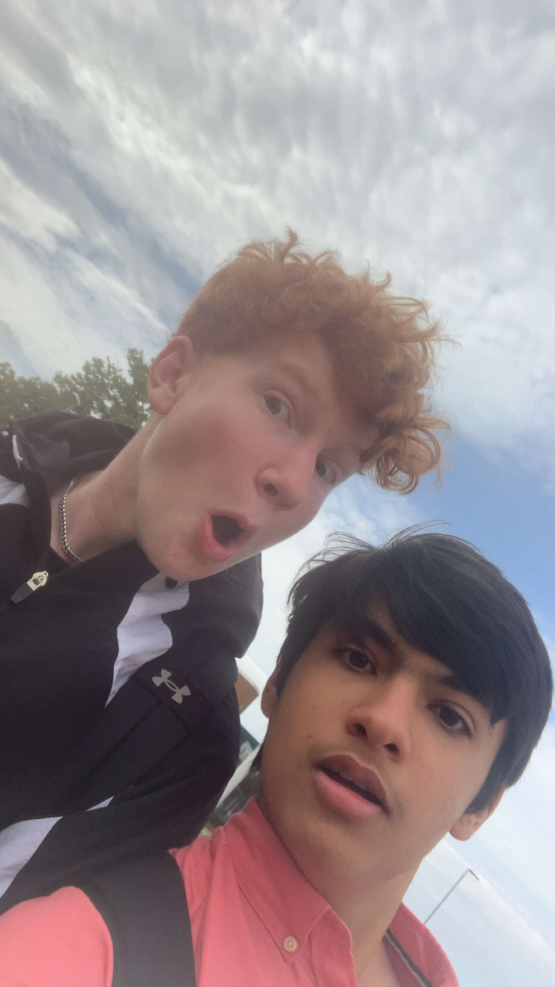
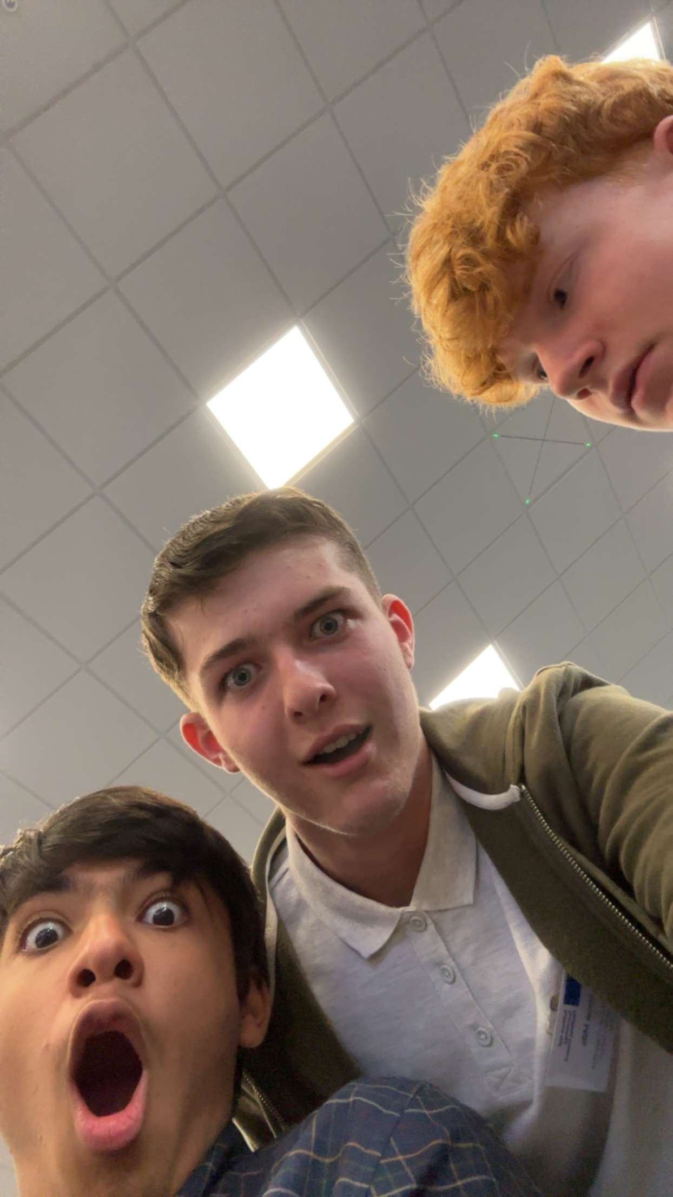
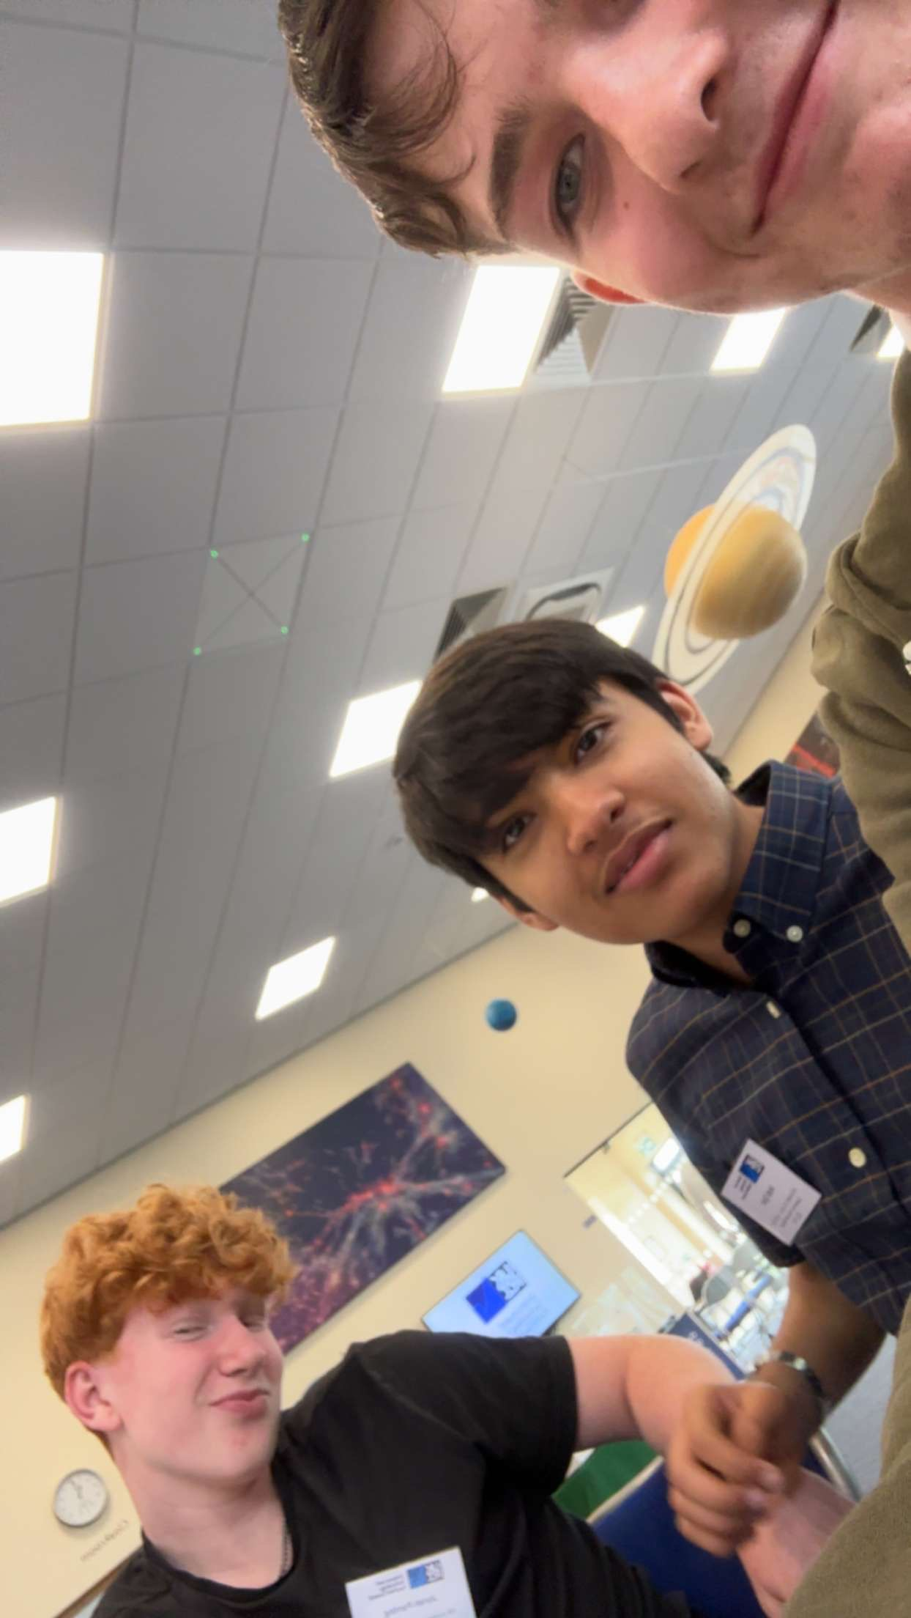
Harrison Mills – About me
One of my favourite hobbies is Karate, and I’ve always enjoyed going out and doing lots of walking from a young age
I enjoy working at a bar, and play videogames almost.
I enjoy messing around with my friends when I’m not working.

Slide 9
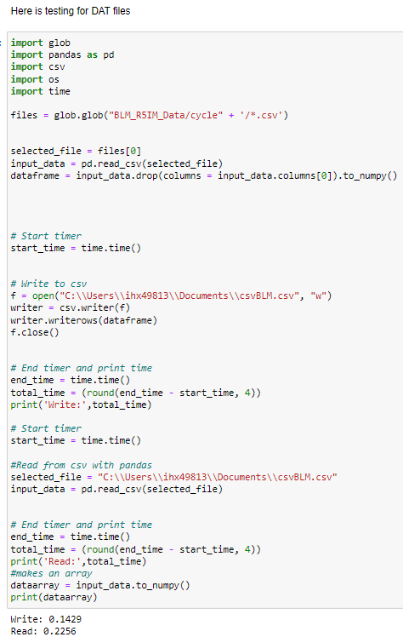
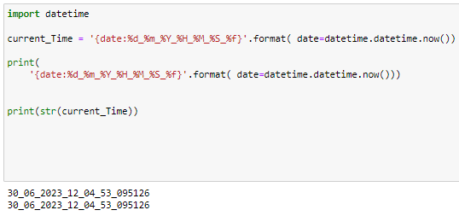
Stage 1 Projects: Group 1E: File Handling
I did mostly testing
I did testing for data files (.DAT)
I did testing for pickle files (.pkl) which I couldn’t get to work (regrettably)
I wrote code to add the exact date and time of files upon creation

Slide 10

Stage 2 Projects: Waterfall GUI
From the beginning, I worked on collaborations – acquiring useful code from other groups and sharing useful code from 1E.
Then I moved on to writing functions for the GUI – I wrote code for a function to change the z axis (which might not have been added to the final version)

Slide 11
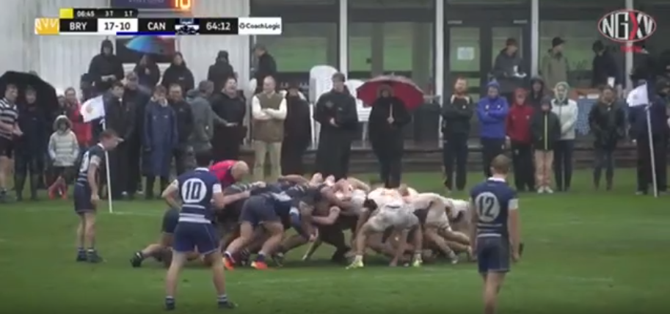
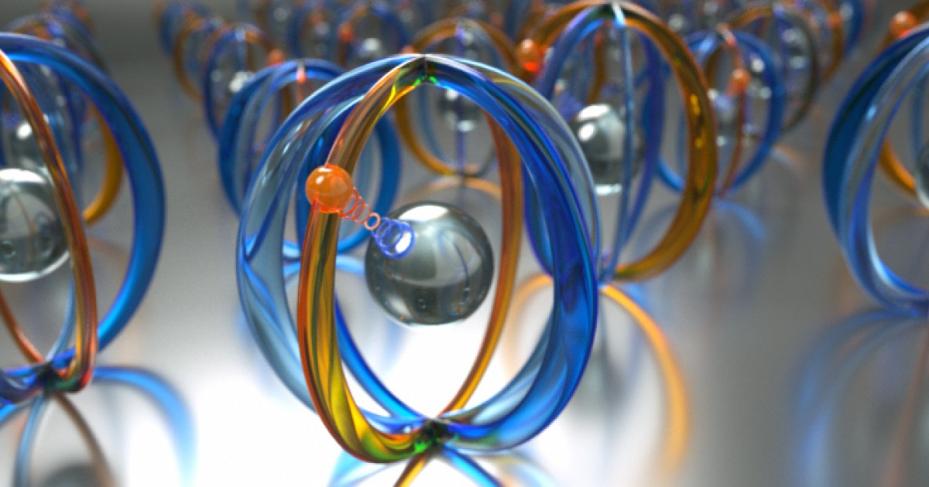
Benny
Sport
Double Bass
Drama
Ivan Scivetti
Gilberto Teobaldi
Notes:
rug, foot, hoc, big cello, big guitar, film

Slide 12
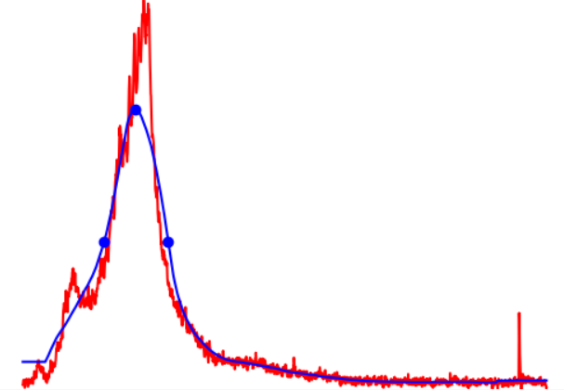
Stage 1 Projects: Group 1D: Peak Finding
Loss Signal
Smoothened Signal
Baseline
Height
FWHM
Notes:
Tell us:
What you contributed to your team / goals / tasks
Don’t forget update presentations, demo presentations, these presentations, communication tasks, documentations tasks – we focus on the product but this requires a vast amount of other contribution types (not just some python code)
Focus on a few things – remember you should aim to get this slide done in 30 – 45 seconds
What you learnt (if you want)
What you enjoyed or the opposite (if you want)
Your struggles and victories, personal and group / cohort (if you want)
Your self defined success (if you want)
Other interesting things (if you want)

Slide 13
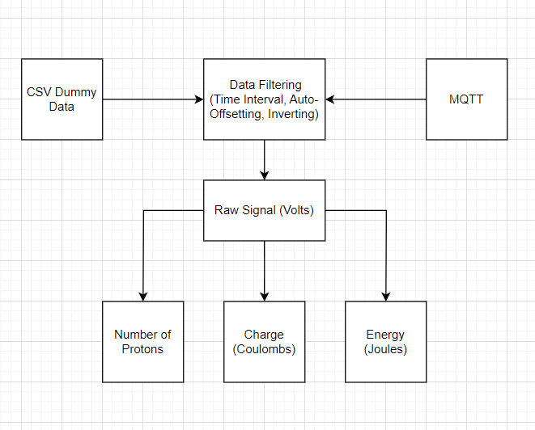
Stage 2 Projects: Waterfall GUI
Notes:
Tell us:
What you contributed to your team / goals / tasks
Don’t forget update presentations, demo presentations, these presentations, communication tasks, documentations tasks – we focus on the product but this requires a vast amount of other contribution types (not just some python code)
Focus on a few things – remember you should aim to get this slide done in 30 – 45 seconds
What you learnt (if you want)
What you enjoyed or the opposite (if you want)
Your struggles and victories, personal and group / cohort (if you want)
Your self defined success (if you want)
Other interesting things (if you want)

Slide 14
Personal Introduction & How Has This Work Experience Benefited You?
Things about me, I guess:
Adventures:
i’ve ventured off to other places, i guess.
Brazil
France
Netherlands
Belgium
Germany
Italy
Spain
Portugal
Achievements:
Somehow did not lose all my sanity over why my code isn’t working throughout the entirety of this fortnight.
Likes:
Travelling abroad and getting to know places
Fossil-hunting
(like the complete nerd I am)
Running
(from the border patrol)
How has this experience benefited you?
There are no photos because I’m a boring person.
Deal with it, nerds.
>:¬)

Slide 15
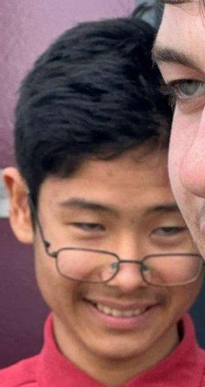
Personal Introduction & How Has This Work Experience Benefited You?
Things about me, I guess :
Adventures:
i’ve ventured off to other places, i guess.
Brazil
France
Netherlands
Belgium
Germany
Italy
Spain
Portugal
Achievements:
Somehow did not lose all my sanity over why my code isn’t working throughout the entirety of this fortnight.
Likes:
Travelling abroad and getting to know places
Fossil-hunting
(like the complete nerd I am)
Running
How has this experience benefited you?
This experience benefited me by challenging me to be creative and innovative within a workplace environment.
There are no photos because I’m a boring person.
Deal with it, nerds.
>:¬)

Slide 16
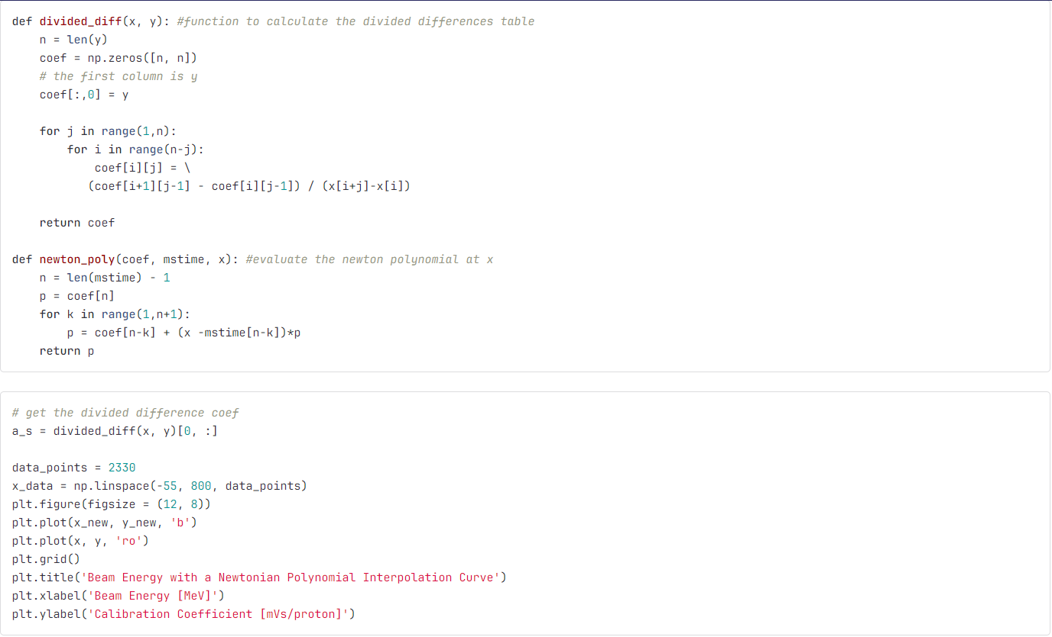
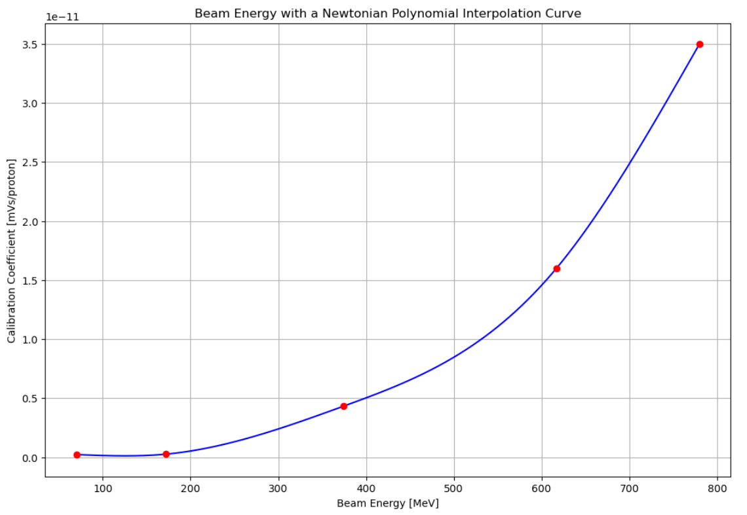
Stage 1 Projects: Group F: Energy Conversion - Calibration Interpolation
What I did in Stage 1:
I coded some interpolation methods, most notably the Newtonian and Lagrange Polynomial Interpolation.
An achievement which Toby Hall (♡) greatly appreciated for
During this process, I learnt that matplotlib and numpy…
ARE THE MOST ANNOYING PYTHON LIBRARIES, THESE SINGLEHANDEDLY ALMOST SENT ME TO THE ASYLUM
I struggled at everything, but copy-pasting all the code from the internet was an excellent play by me.
The pictures behind this text shows the code and output of a Newtonian Polynomial Interpolation Curve

Slide 17
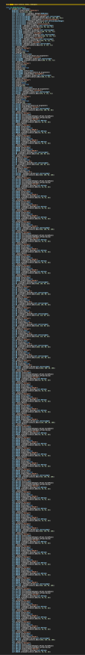
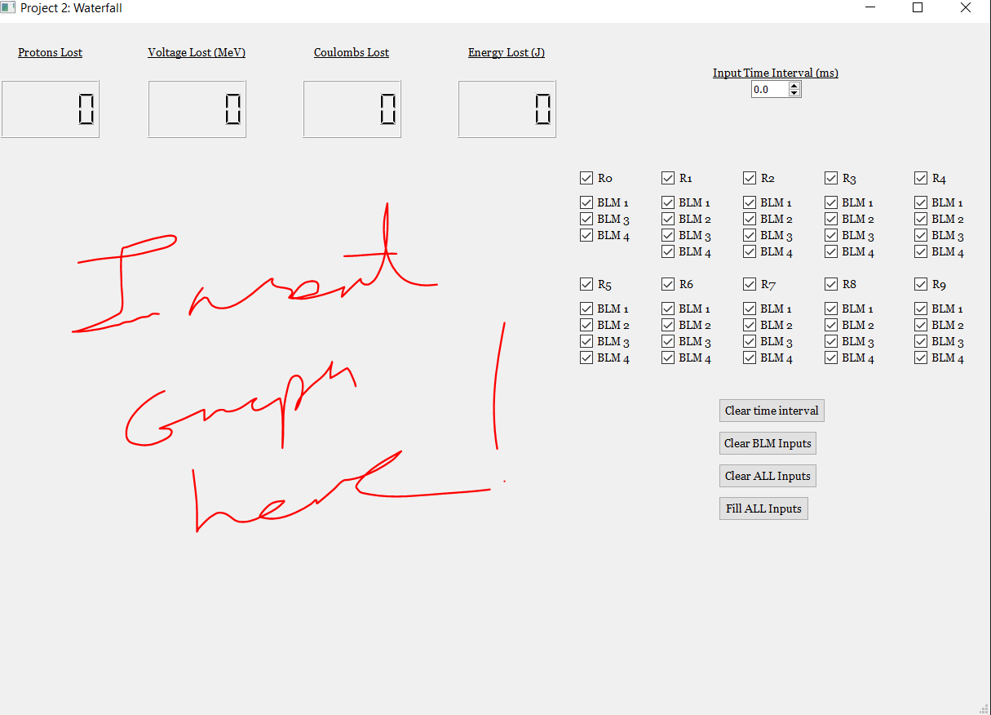
Stage 2 Projects: Waterfall GUI
What I did in Stage 2:
Me, along with ChatGPT (♡) created a (almost) fully functioning GUI
From the photo to the left, that is 430/**870** lines of code, all to make what is on the photo to the right.
I’ve learnt how to make GUI parts interact with other GUI parts, through the help of my good friend, ChatGPT (♡)
I enjoyed and hated making the GUI, but nothing can beat the satisfaction of the GUI officially working.
I felt like a father, watching their child succeed in life.
Whilst at the same time, being completely sad and pathetic.

Slide 18
Acknowledgments
Public Engagement Team
Haroon
Esher
Bill
All the other work experience students
Ansh - photography

Slide 19
GUI Demo
5 minutes max, show live data, demo mode, change some settings and show features

Slide 20
Thank you
Questions?

